Slide 1
KPK Excise & Taxation system using Shibboleth
FYP-I Final Presentation
Group Members
Umar Rizwan (15-6023)
Usman Ashraf (15-6016)
Subhan Ahmad (15-6118)
Supervised by
Mr. Fazle Basit
Evaluators
Dr. Muhammad Nauman
Dr. Usman Habib
1 of 8

Slide 2
KPK Excise & Taxation system using Shibboleth
FYP-I Final Presentation
Outline
Problem Statement
Project Objective
Proposed Solution
  Architecture
  Configuration (Idp & Sp)
Demo of Project.
Q/A session.
2 of 8

Slide 3
KPK Excise & Taxation system using Shibboleth
FYP-I Final Presentation
Problem Statement
The Excise department is engaged in collection of taxes.
They need their Token Taxation & Vehicle Transfer to be centralized.
Original district to be updated automatically.
3 of 8

Slide 4
KPK Excise & Taxation system using Shibboleth
FYP-I Final Presentation
Project Objective
To build a system which can perform following functions
Centralized system by applying federated identity management using shibboleth.
Automatic update of Taxation and transferring of vehicles
4 of 8

Slide 5
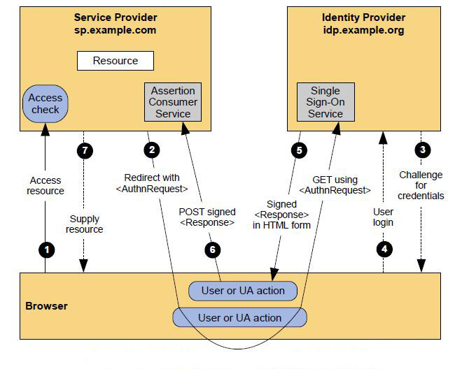
KPK Excise & Taxation system using Shibboleth
FYP-I Final Presentation
5 of 8

Slide 6
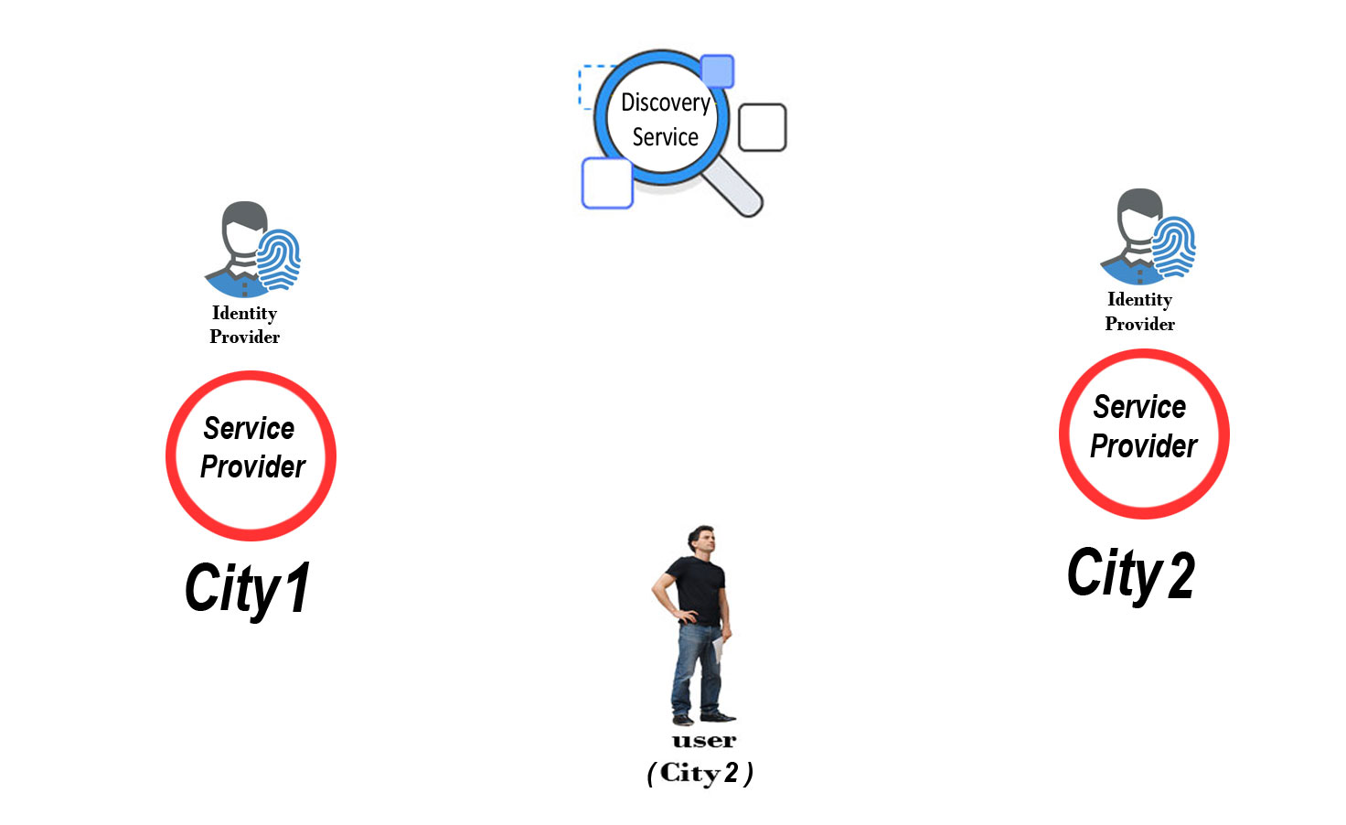
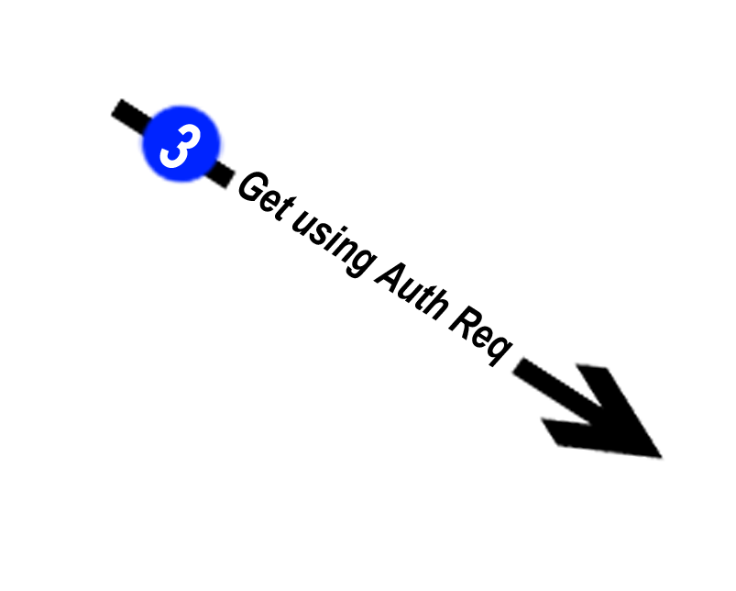
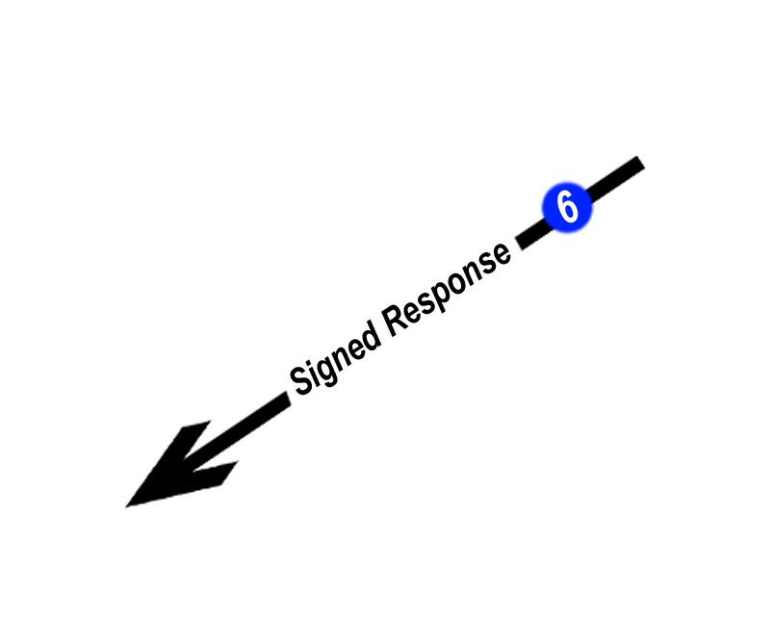
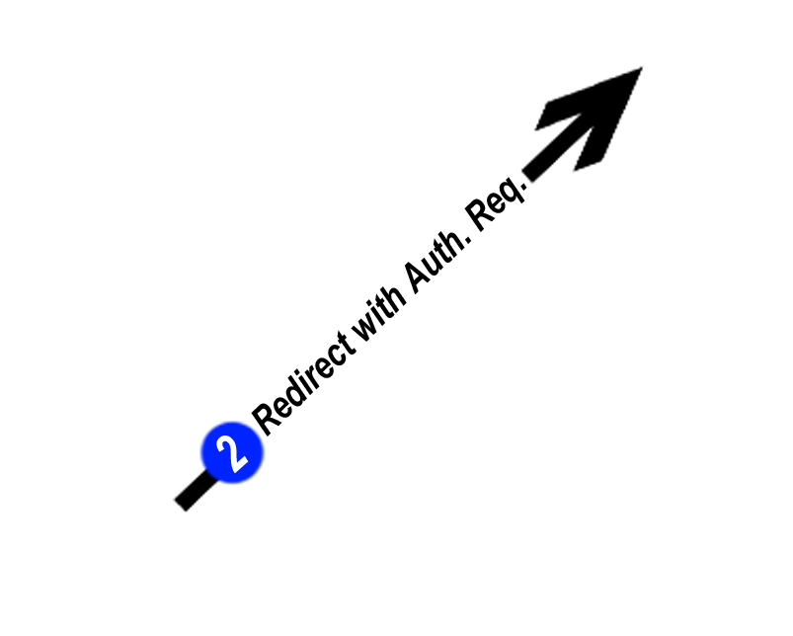
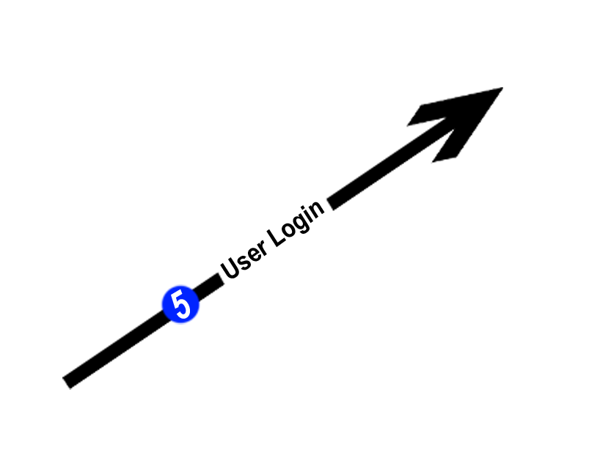
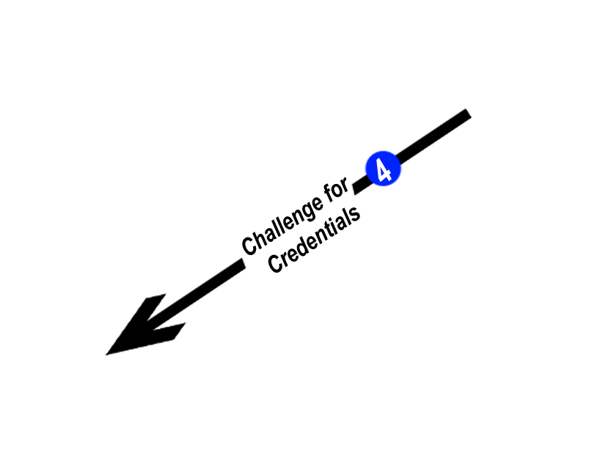
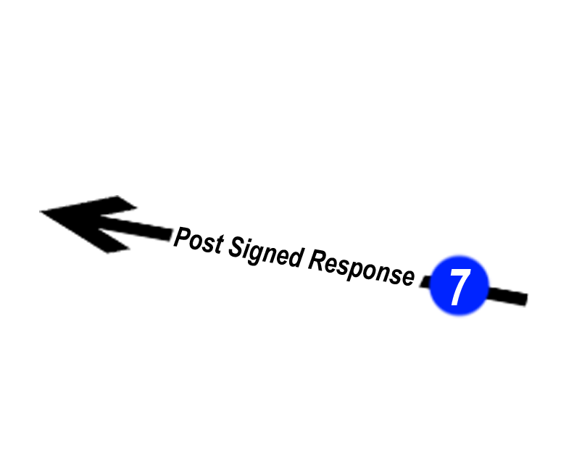
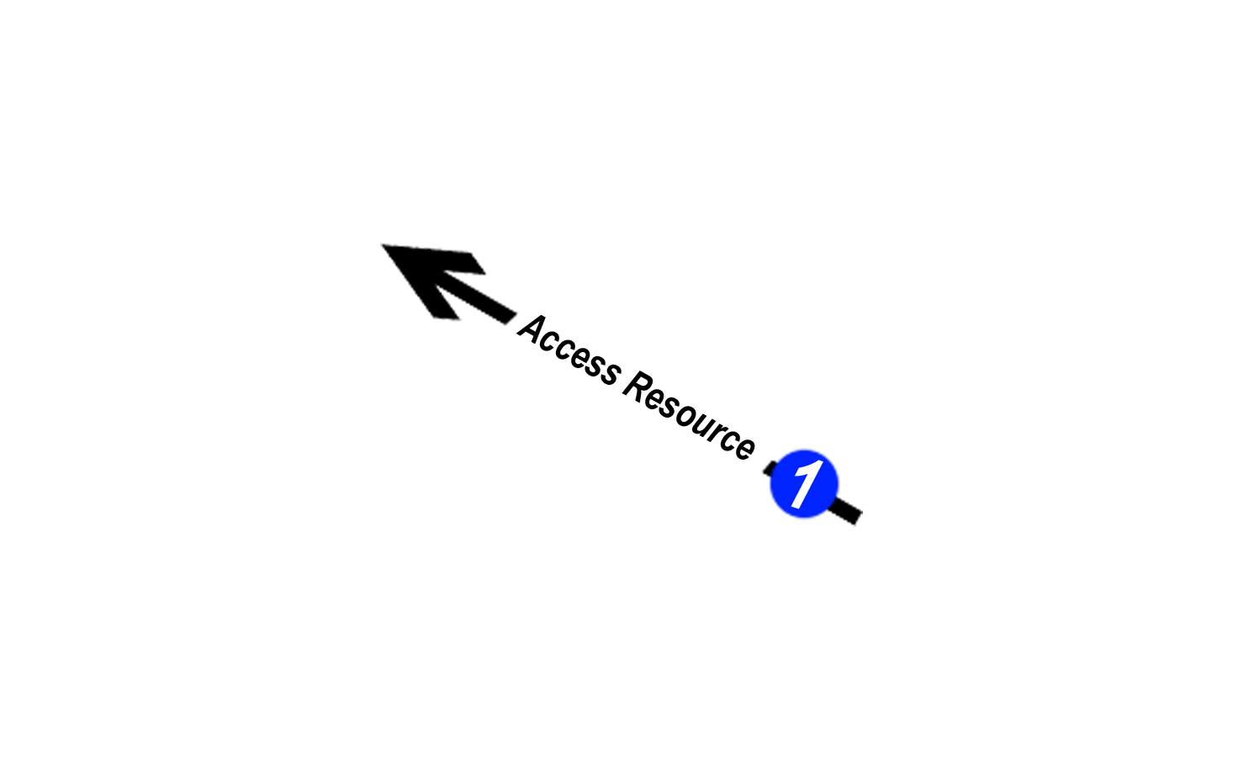
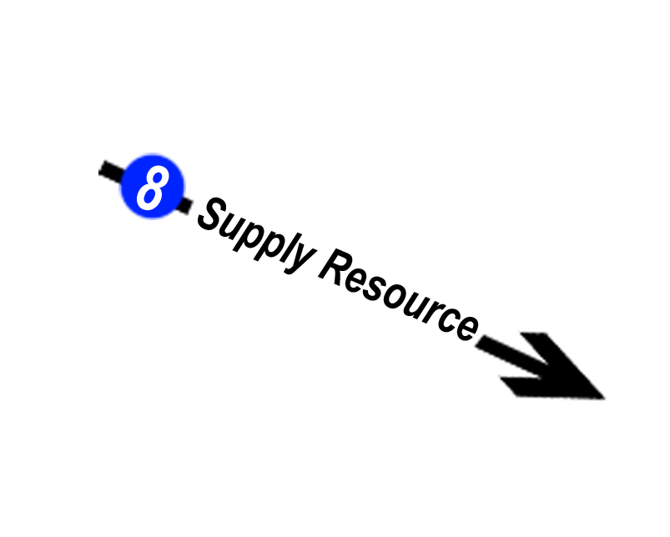


Slide 7
KPK Excise & Taxation system using Shibboleth
FYP-I Final Presentation
Identity Provider Configuration:
Modify idp
Modify access control
Providing SP metadata to IDP
6 of 7

Slide 8
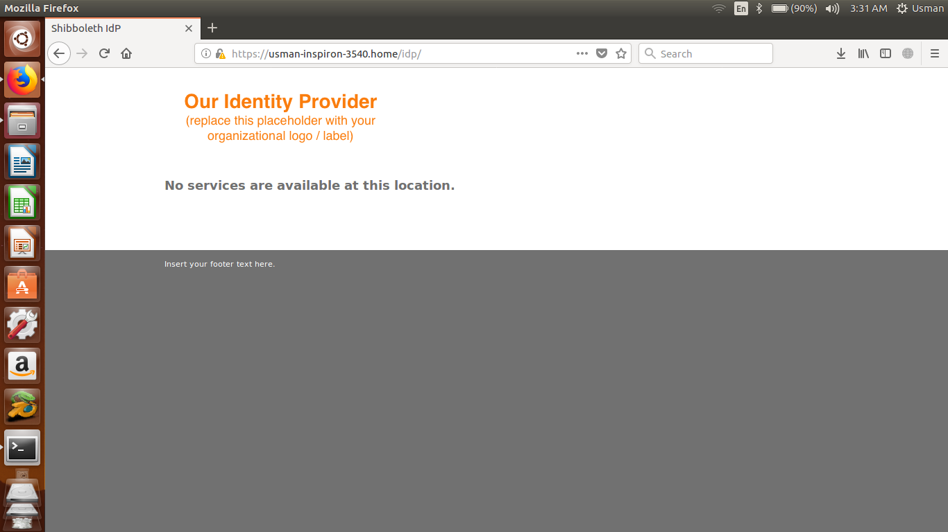

Slide 9
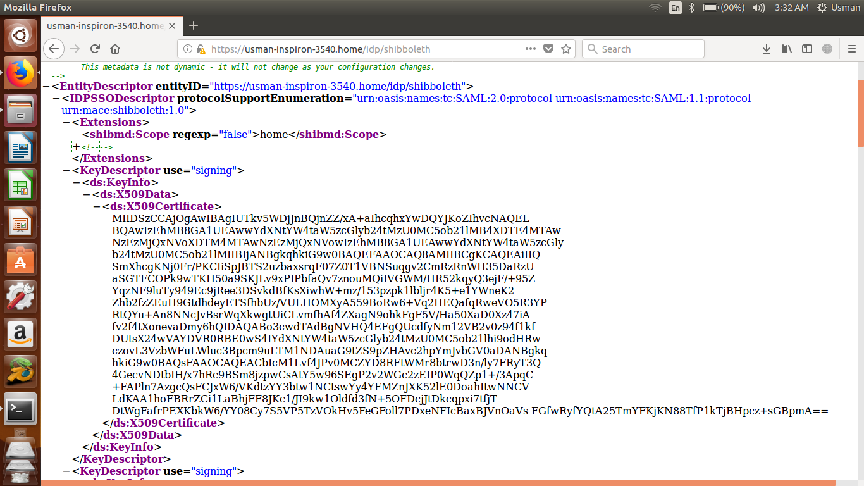

Slide 10
KPK Excise & Taxation system using Shibboleth
FYP-I Final Presentation
Service Provider Configuration:
Modify shibboleth file
Providing SP metadata to IDP
7 of 8

Slide 11
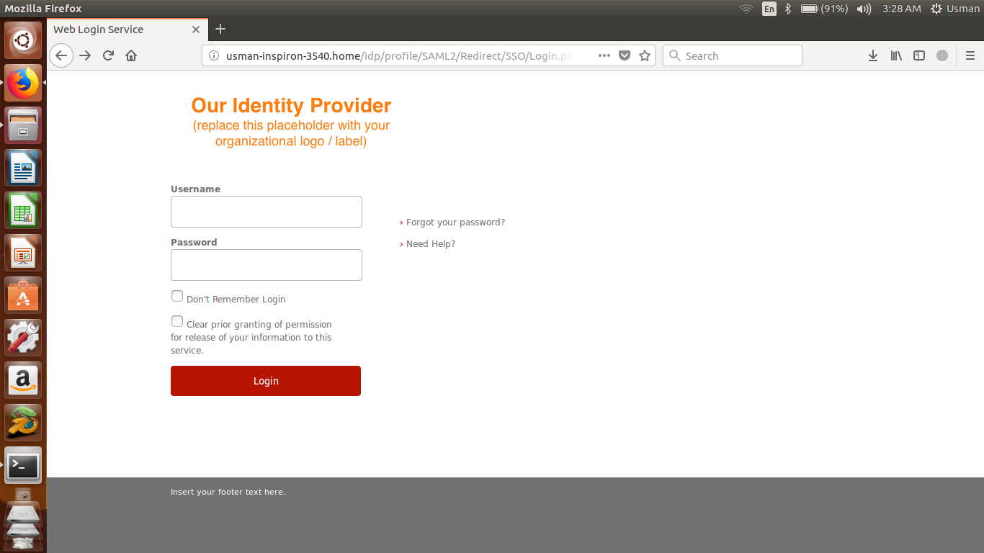

Slide 12
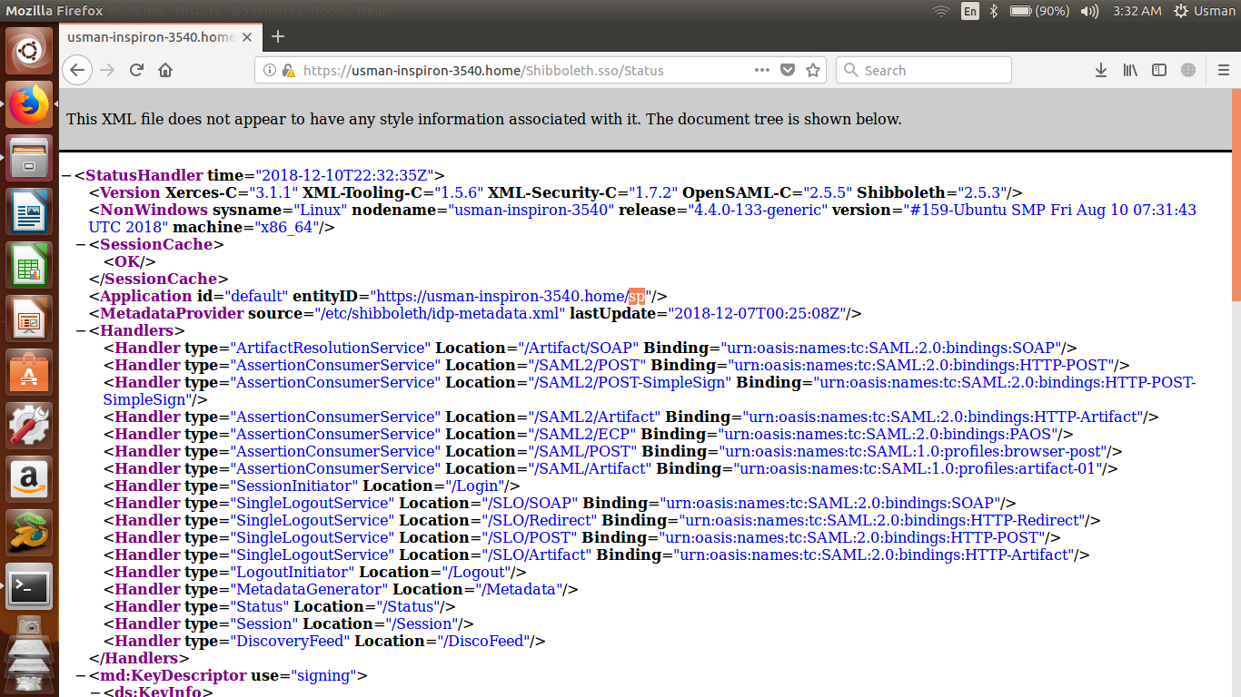

Slide 13
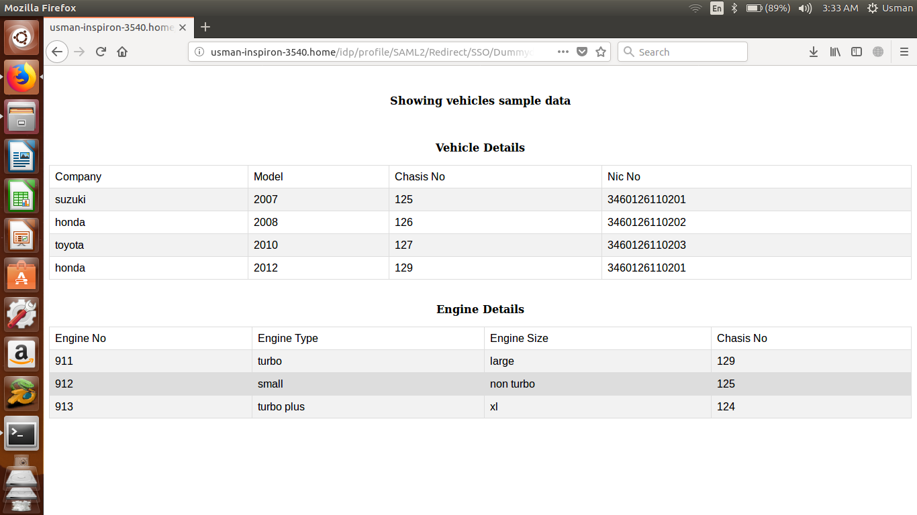

Slide 14
KPK Excise & Taxation system using Shibboleth
FYP-I Final Presentation
Any Questions
Thank you
8 of 8

